Slide 1
Looking Beyond The Event Horizon: Modeling the Synapse
by Yves Konigshofer

Slide 2
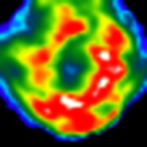
Introduction
Cell-to-cell (e.g. T cell / APC) contact sometimes leads to the formation of a synapse
Over the past few years, more and more molecules have been identified that accumulate at a synapse
    TCR, MHC, LFA-1, ICAM-1, CD2, CD4, CD8, CD28, etc.
Different patterns have resulted from the accumulation of these molecules
Picture from Johannes Huppa

Slide 3
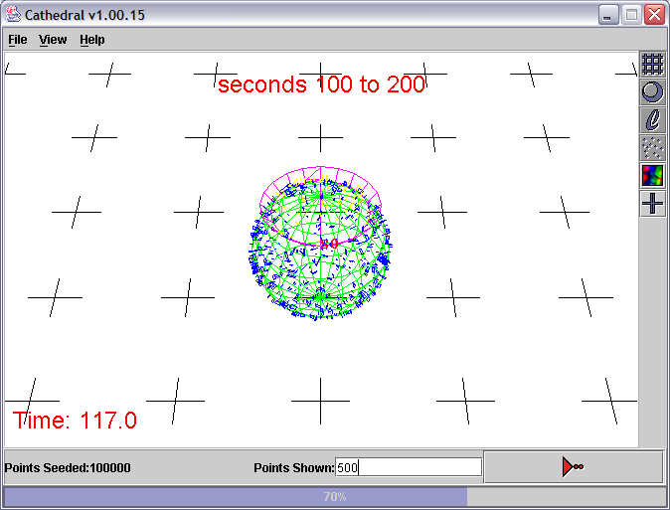
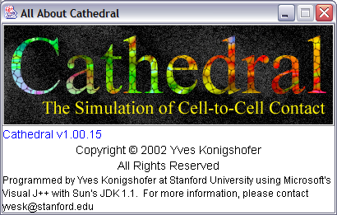
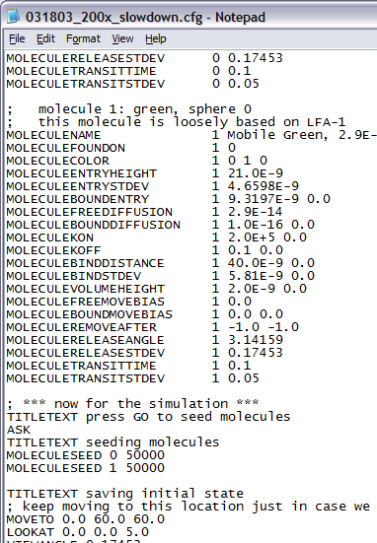
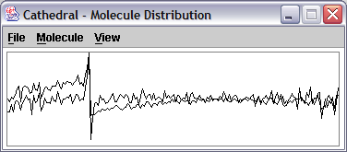
A Simulation of Cell-to-Cell Contact

Slide 4
Why Simulate Cell-to-Cell Contact?
To predict what will happen under conditions that are difficult to analyze in vitro or in vivo
Reverse Engineering; to determine what pieces of the puzzle are currently missing, but are needed, to properly characterize and understand the events that shape cell-to-cell contact and lead to the formation of a synapse

Slide 5
The Contact Area (Synapse)
There are two cells and one contact area
This contact area is divided into rings and sectors, which give rise to regions
Most calculations are done on a per-region basis
Molecules interact with other molecules that are found inside of the same region
Bound molecules cannot leave the contact area while they are still bound

Slide 6
Defining the Characteristics of Different Types of Molecules
Optimal binding distances, confinement distances, bound and free diffusion coefficients, bound and free diffusion biases, bound and free optimal region entry heights, on-rates for binding, off-rates for release, binding times for endocytosis, transit times until exocytosis, modifiers for many of these parameters, color, etc.

Slide 7
Release, Diffusion, and Binding
Release is calculated using the k_{off} values for the receptor/ligand complexes
Diffusion is calculated using the diffusion coefficient, D, for the molecules or complexes
Binding is calculated using the 3D k_{on} values and confinement distances for the molecules trying to bind inside of particular regions, their concentrations inside of these regions, and the distance between the opposing membranes

Slide 8
Calculating Diffusion
b
x
x_{b}
a
x_{a}

Slide 9
Calculating Binding and Release

Slide 10
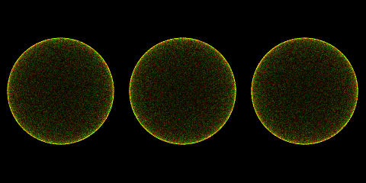
Three Patterns of Binding
Red Immobile 2x Reduction in D 200x Reduction in D

Slide 11
The Event Horizon Appears when Both Molecules are Mobile

Slide 12
Testing the System
Two cells with 5μm radii
100,000 mobile MCC/IE^{k} molecules
25,000 immobile 2B4 TCR molecules
k_{on} = 1.57x10³ M⁻¹s⁻¹
k_{off} = 0.063 s⁻¹
confinement distance = 13.17nm
MCC/IE^{k} should be at the same concentration as the K_{D} (40μM)
Half of the TCR molecules should be bound

Slide 13
The Expected Binding is Observed
MCC/IE^{k}
2B4 TCR

Slide 14
Modeling the Effects of LFA-1 (CD11a/CD18) Activation
LFA-1
    an integrin (α_{L}β₂)
    binds ICAM-1
    essentially immobile when cells are resting but mobile when cells are activated (Kucik et al.)
      resting D ≈ 2.3x10⁻¹⁵ m²s⁻¹
      activated D ≈ 2.9x10⁻¹⁴ m²s⁻¹
    affinity for ICAM-1 changes after activation (Lollo et al., Tominaga et al.)
      resting k_{on} ≈ 3.7x10² M⁻¹s⁻¹; k_{off} ≈ 0.033 s⁻¹
      activated k_{on} ≈ 2.0x10⁵ M⁻¹s⁻¹; k_{off} ≈ 0.1 s⁻¹

Slide 15
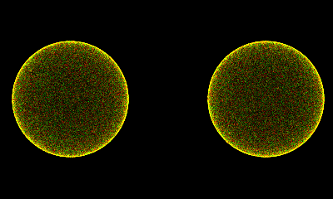
One Minute of LFA-1 Activation and ICAM-1 Binding
Resting Activated

Slide 16
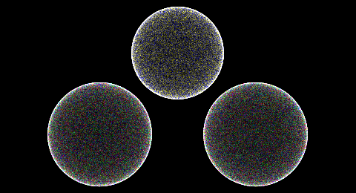
Simulating T cell Activation
(random diffusion)
Large Molecule
TCR MHC
LFA-1 ICAM-1

Slide 17
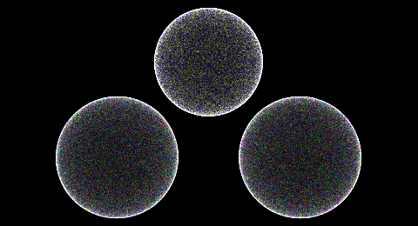
Simulating T cell Activation
(directed diffusion of the TCR and large molecule)
Large Molecule
TCR MHC
LFA-1 ICAM-1

Slide 18
Observations and Conclusions
When mobile molecules bind each other on opposing cells, the standard result is the formation of a ring
The simulation properly calculates the amount of molecules that are bound based on the k_{on} and k_{off} values for their interactions
Directed as opposed to random diffusion is needed for the formation of the central TCR / MHC cluster during T cell / APC interactions
Lots of parameters still need to be measured to accurately model cell-to-cell interactions

Slide 19
Acknowledgements
Chien lab
Davis lab
    Johannes Huppa
    Cenk Sumen
    Lawren Wu (Genetech)
Duke University
    Jun Yang

Slide 21
The Representation of Cells, Molecules, and the Synapse
There are two cells that touch each other in a contact area (synapse)
These cells are represented as one or more spheres
Each sphere has a representation of the contact area
There are one or more different types of molecules
Each type of molecule is found on one particular sphere
Definable amounts of molecules are found on the surfaces of the spheres
Only those molecules that are found inside of the contact area interact with each other

