Slide 1
Close Encounters of the Cellular Kind: Modeling T Cell Activation
Yves Konigshofer
Microbiology and Immunology
Friday Noon Seminar
28 January 2005

Slide 2
T Cell Activation and Synapse Formation
Animations were kindly provided by Johannes Huppa (Davis lab)
Notes:
When antigen presenting cells, such as Macrophages, ingest bacteria they present peptides thereof within MHC class II. The recognition of such foreign peptides can lead to the activation of T cells; which then results in synapse formation.

Slide 3
Simulating Cell-to-Cell Interaction
It is possible to carry out experiments in silico that would be difficult to carry out in vitro
There are great benefits in attempting to reverse engineer a process

Slide 4
The Simulation
k_{deactivate (ext)}
k_{on}
t_{activate}
k_{off}
k_{off}
k_{on}
k_{endo (inactive,free)}
k_{endo (inactive,bound)}
k_{endo (active,bound)}
k_{exocytosis}
k_{endo (active,free)}
k_{deactivate (int)}
k_{degrade (inactive)}
k_{degrade (active)}
synthesis

Slide 5
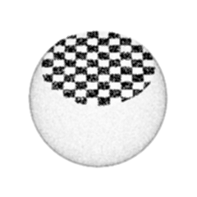
The Equations for Release, Diffusion and Binding
Release
Diffusion
Binding

Slide 6
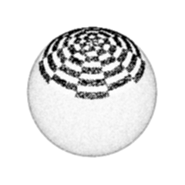
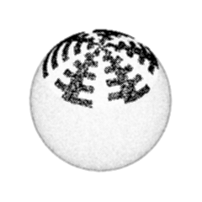
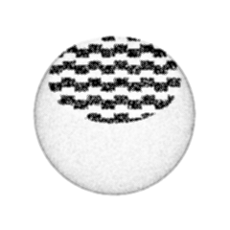
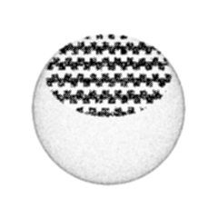
The 5 Different Region Models for the Contact Area

Slide 7
Membrane Spacing

Slide 8
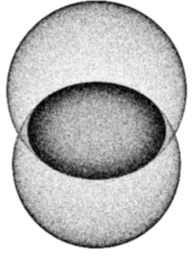
Equilibrium Binding Between Two Cells
cell radii = 5 μm
contact area radius = 4 μm
k_{on} = 1.57x10³ M⁻¹s⁻¹
k_{off} = 0.063 s⁻¹
D = 1x10⁻¹³ m²s⁻¹
10,000 immobile molecules
red
10,167 mobile @ 12.3 nm
green
10,833 mobile @ 1.37 nm
blue
11,500 mobile @ 0.15 nm

Slide 9
There are Two Phases of Binding
cell radii = 5 μm
contact area radius = 4 μm
k_{on} = 1.57x10³ M⁻¹s⁻¹
k_{off} = 0.063 s⁻¹
D = 1x10⁻¹³ m²s⁻¹
red
60,000 immobile
19,000 mobile
green
30,000 immobile
14,500 mobile
blue
10,000 immobile
11,500 mobile

Slide 10
The Rate of Diffusion Affects the Second Phase
cell radii = 5 μm
contact area radius = 4 μm
k_{on} = 1.57x10³ M⁻¹s⁻¹
k_{off} = 0.063 s⁻¹
D = 1x10⁻¹³ m²s⁻¹
60,000 immobile
19,000 mobile
red
D = 1x10⁻¹³ m²s⁻¹
green
D = 1x10⁻¹⁴ m²s⁻¹
blue
D = 1x10⁻¹⁵ m²s⁻¹

Slide 11
The Chien Lab Works on γδ T Cells
T10 and T22 are MHC class Ib molecules and are two of the very few known ligands of γδ T cells
Activation (e.g., through LPS) leads to T10 expression
The G8 γδ TCR recognizes T10/T22 of the b haplotype with a high affinity
k_{on} = 6.53x10⁴ M⁻¹s⁻¹; k_{off} = 8.1x10⁻³ s⁻¹
the average G8 γδ TCR/T10^{b} interaction lasts for 2 minutes!
When G8 γδ T cells encounter T10/T22^{b}-expressing cells, they activate and temporarily disappear

Slide 12
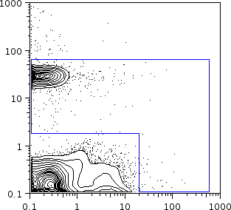
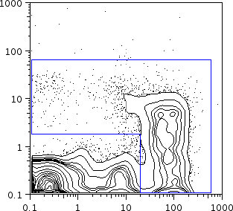
γδ T Cell Activation
control activated
γδ TCR
CD69

Slide 13
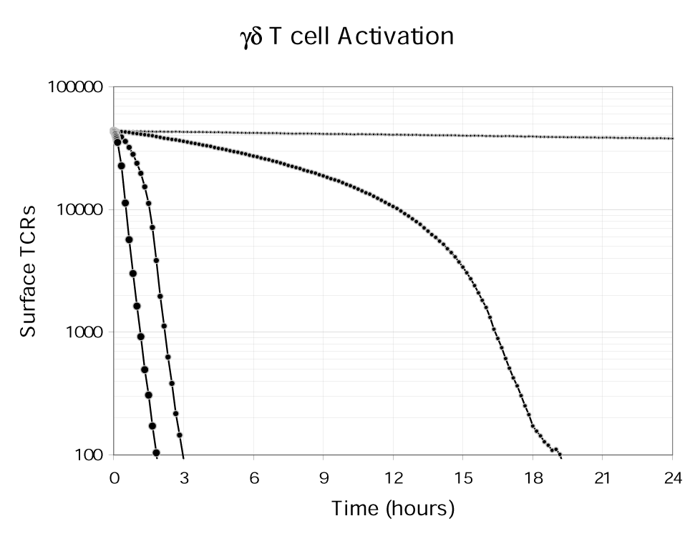
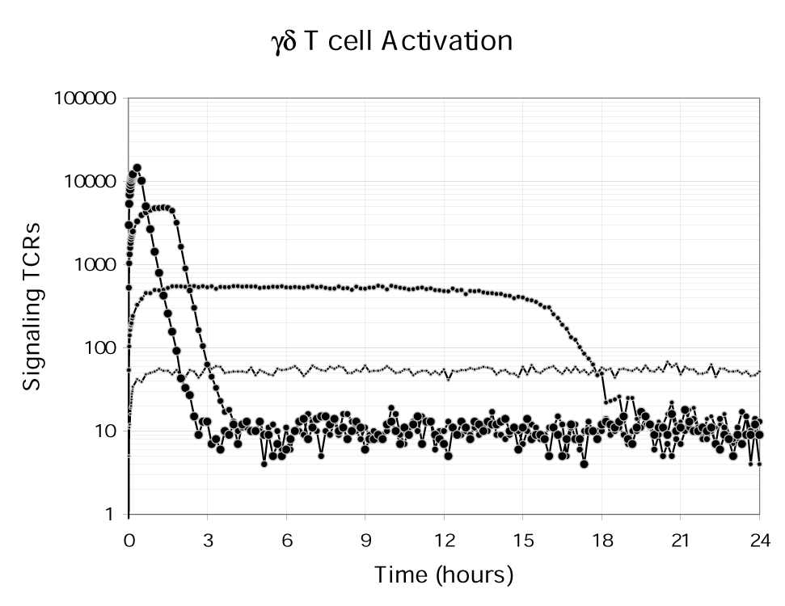
Ligand Numbers Affect TCR Internalization and Perhaps Signaling

Slide 14
Analysis of Synapse Formation During a 3 Hour Simulation of a G8 γδ T Cell Recognizing Its Ligand, T10^{b}, on an APC
50,000 G8 γδ TCR that recognize 5,000 T10^{b}
30% of G8 γδ TCRs use directed movement of 0.05 μm·s⁻¹
k_{on} = 6.53x10⁴ M⁻¹s⁻¹; k_{off} = 8.1x10⁻³ s⁻¹
D_{γδTCR} = 0.5x10⁻¹⁴ m²s⁻¹; D_{T10} = 2.0x10⁻¹⁴ m²s⁻¹
50,000 LFA-1 and 50,000 ICAM-1
k_{on} = 2.0x10⁵ M⁻¹s⁻¹; k_{off} = 0.1 s⁻¹
D_{LFA-1} = 2.9x10⁻¹⁴ m²s⁻¹; D_{ICAM-1} = 2.0x10⁻¹⁴ m²s⁻¹
12,500 CD2 and 50,000 CD48
30% of CD2s use directed movement of 0.05 μm·s⁻¹
k_{on} = 1.0x10⁵ M⁻¹s⁻¹; k_{off} = 6.0 s⁻¹
D_{CD2} = 2.0x10⁻¹⁴ m²s⁻¹; D_{CD48} = 2.0x10⁻¹⁴ m²s⁻¹

Slide 15
Parameters for the G8 γδ TCR
0.01155
6.53E+4
20 s
8.1E-3
8.1E-3
6.53E+4
0.25E-3
0.25E-3
1.97E-3
1.67E-3
1.97E-3
0.01155
0.0
0.1
0.0167

Slide 16
Questions to Address
Is there a difference if γδ TCRs and CD2s use directed movement for only 20 minutes?
Is there a difference if γδ TCRs and CD2s that use directed movement can drag along bound T10s and CD48s, respectively?

Slide 17
Receptor Levels are not Greatly Affected by the Different Conditions

Slide 18
TCRs with Directed Movement Bind Sooner…

Slide 19
…Exhibit a Faster Rate of Removal…

Slide 20
…and Exhibit a Faster Fractional Rate of Removal

Slide 21
The Representation of Cells and Molecules
ICAM-1
T10
CD48
big molecule
LFA-1
G8 γδ TCR
CD2

Slide 24
Parameters for the G8 γδ TCR
0.01155
6.53E+4
20 s
8.1E-3
8.1E-3
6.53E+4
0.25E-3
0.25E-3
1.97E-3
1.67E-3
1.97E-3
0.01155
0.0
0.1
0.0167

Slide 25
What Happens in 20 Seconds?
Diffusion
a membrane protein moves 1 to 3 μm
a soluble protein moves 30 to 100 μm (3 to 10 cell diameters)
T cells appear to activate really fast
What happens in 1 second
a membrane protein moves to 0.2 to 0.6 μm
a soluble protein moves 7 to 24 μm (1 to 2 cell diameters)
100-fold less potent weak agonists remain bound for 2 seconds
How do T cells tell time?

Slide 26
Acknowledgements
Yueh-hsiu Chien
everyone from the Chien lab
Johannes Huppa (Davis lab)

Slide 27
Studies of γδ T Cell Activation: From the Intestine to the Spleen and also in Silicon
2 to 3 p.m., Munzer Auditorium
on Tuesday the 8th of February

